Slide 1
Weather and Crime A look at the potential impact of temperature on crime rates in Houston, Texas

Slide 2
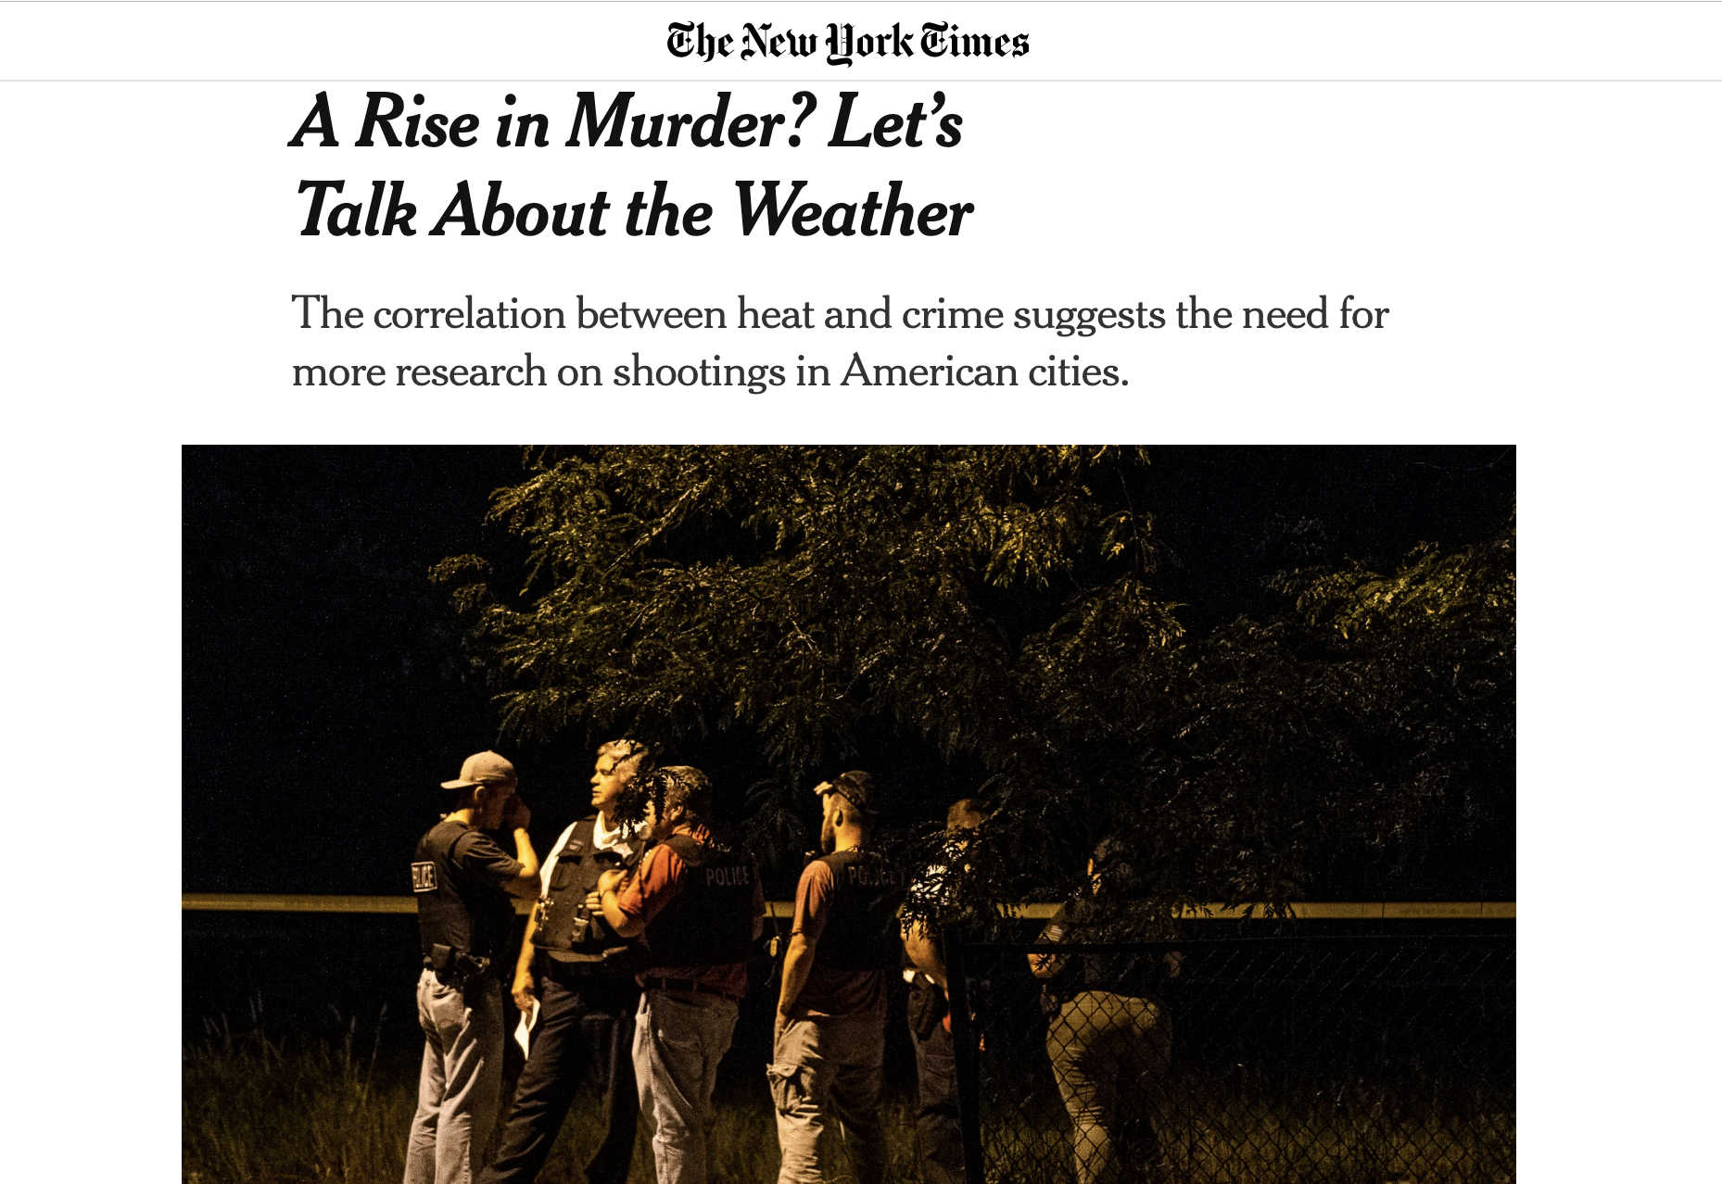
Where did we get the idea?
Investigating the relationship between weather and violence in Baltimore, Maryland, USA
“When adjusting for temporal and meteorological factors, maximum daily temperature was positively associated with total trauma, intentional injury, and gunshot wounds presenting to Johns Hopkins Hospital along with total crime, violent crime, and homicides in Baltimore City. ”

Slide 3
Implications
We did not find a statistically significant linear relationship between average yearly temp and incidence of violent crime and maximum yearly temp and incidence of violent crime in Harris county, which was in keeping with an observation from the article that provided the inspiration for this investigation that
“In Southern cities like Atlanta and New Orleans, the effect exists but is weaker.”
We did find a statistically significant relationship between incidence of violent crime and median household income in Harris County which warrants much more investigation. Why does a general rise in economic means across the county seem to lead to MORE violent crime?
Crime itself is a phenomenon of human behavior influenced by multiple factors including sociological, economic, environmental, and psychological factors to name a few. These are beyond the scope of this particular project but make for interesting future investigations.

